Slide 1
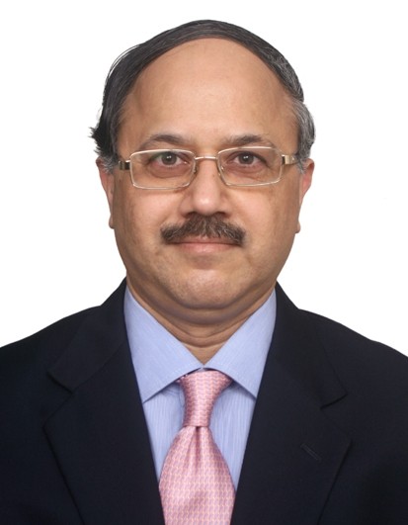
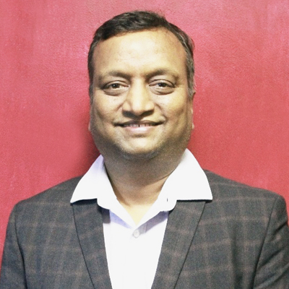
Mr. Shantanu Bhadkamkar
(Chairman : Maharashtra State Development Council)
Managing Director, ATC Group &
Chairman, Rotomac Containers Pvt Ltd
He done his B.Sc., Customs CBLR Rule 6 (CHALR Rule 9), OPM – Harvard Business School and Honorary Fellow of Narottam Morarjee Institute of Shipping (NMIS).
He is the Immediate Past President of Association of Multimodal Transport Operators of India (AMTOI), Past President and Advisor to Maharashtra Chamber of Commerce, Industry and Agriculture (MACCIA) and Indian Maritime University (IMU), TN Apex Skill Training Centre for Transportation and Logistics, Executive Member in the Governing Council (Nominee) of Logistics Sector Skill Council.
Mr. Umesh Kamble
Co Chair- Maharashtra State Development Council &
Founder & Director
Farm to Fork Solutions
Mr. Umesh Kamble is a first generation entrepreneur and is Founder and Managing Director of Farm To Fork Solutions India Pvt. Ltd. He is technocrat having 15 years of experience in Food processing Set up, Legal Liaisoning & Licensing Services for Food, Drug, Cosmetic and other Industries in India,
He has worked with various MNC viz., SGS India Pvt Ltd, Reliance Retail Ltd, Godrej Agrovet Ltd. Umesh Kamble holds Food Sciences Degree from College of Food Technology, (Marathawada Agricultural University, Parbhani, MH) and M.Sc. (Food Technology) Punjab Agricultural University, Ludhiana , Punjab.
He also holds Diploma in HACCP, ISO 9001:2000 & TQM conducted by Quality Environment & IEC, Pune and Govt. College of Engineering, Pune. Member of Board of Governor of CFTPBN Alumni Association from 2009 Vice President of Association of Food Scientists & Technologists India (AFSTI) – Mumbai Chapter Life Member of All India Agricultural Students Association (AIASA), New Delhi Life Member of Punjab Agriculture University Alumni Association, Ludhiana FoSTaC Trainer for General Manufacturing.

